Slide 1
Distributed Feature Engineering for GNN-based
Fraud Detection System
Group no. : 13
Guide : Prof. Dev Mukherjee

Slide 2
Introduction
Motivation
Solution
Fail to capture relational and temporal patterns in growing digital transaction volumes
Graph Neural Networks (GNNs) can effectively model user-transaction relationships to identify fraudulent behavior

Slide 3
Project Objective
Graph Based Analysis
Detect coordinated fraud networks through graph relationship analysis
Distributed Feature Engineering
Implement distributed architecture with containerized Feature Engineering
Better Fraud Detection
Transform fraud detection from transaction-based to network-aware prevention
Efficient Parallel Processing
Create scalable container orchestration for parallel graph processing

Slide 4
Technologies Required
Core Technologies
Data Processing
Python, FastAPI, TensorFlow,
Parquet, Pandas/NumPy NetworkX
Distributed Architecture
GNN & Fraud Model
Docker, Kubernetes, Kafka , Zookeeper
PyTorch, DGL, GraphSAGE/GCN

Slide 5
Literature Survey
Financial fraud detection using graph neural networks: A systematic review
Author: Soroor Motie, Bijan Raahemi
First systematic literature review exploring GNNs for financial fraud detection, identifies research gaps in unsupervised approaches
"Graph neural networks for financial fraud detection: a review" (2024-2025)
Author: Dawei Cheng, Yao Zou, Sheng Xiang & Changjun Jiang
Most recent comprehensive review revealing GNNs effectiveness in capturing complex relational patterns
"Financial fraud detection through the application of machine learning techniques: a literature review" (2024)
Author: Ludivia Hernandez Aros, Luisa Ximena Bustamante Molano
This article conducts a comprehensive literature review of machine learning (ML) approaches used to detect financial fraud, aiming to map out key contributors, methodologies, fraud types, datasets, and evaluation metrics across the field

Slide 6
Project Summary
Graph Neural Network Fraud Detection: Transaction data → graph conversion → GNN classification with >90% precision target
Distributed Full Graph Replication: Each container gets complete compressed graph copy for simplified training without partitioning complexity
Complete ML Pipeline: Data preprocessing → graph construction → distributed training → feature storage → REST API inference
Production Deployment: Docker containerization, Redis storage, scalability to 1M+ nodes with <100ms latency
Tech Stack: PyTorch + DGL + FastAPI + Docker for enterprise-ready fraud detection system

Slide 7
Expected Flow Chart
Distributed F. E.
Sending requests to containers with graph and features
Graph Construction
Nodes and Edge creation and graph storage
Data processing
Evaluation & Inference
Data gathering from different sources and processing
Combining features and evaluating the fraudulence
Feature Extraction
Feature extraction from calculated features

Slide 8
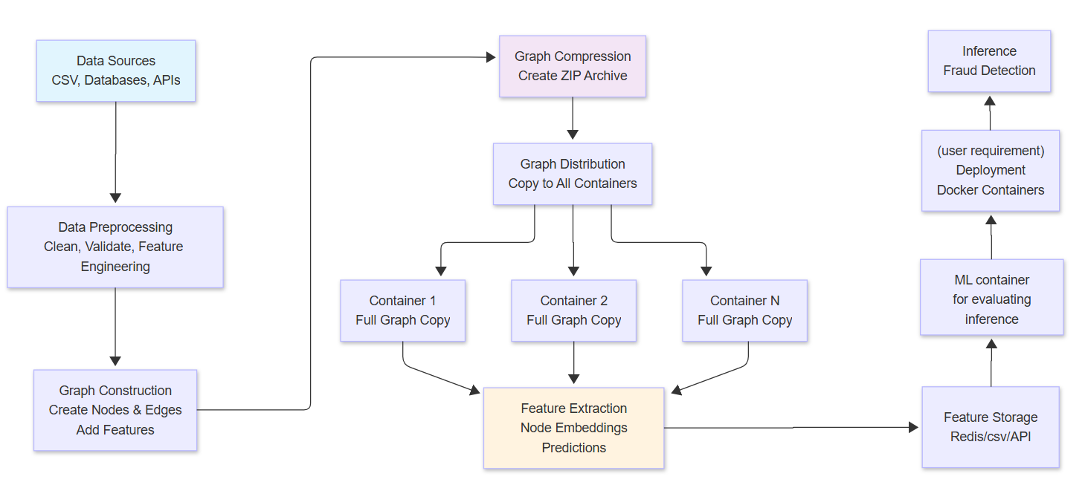
Project Flow

Slide 9
Expected Outcome
Scalable Graph-based Fraud Detection System
Distributed Processing Framework
Enhanced Detection Accuracy
Feature Storage and Retrieval System
Comprehensive Feature Engineering Pipeline
End-to-End Automated Pipeline

Slide 10
Implementation Timeline
Week 1-2
Week 3-4
Requirements analysis, Data preprocessing and graph construction modules
Distributed system architecture design GNN model implementation
01
02
03
04
Week 5-6
Week 7-8
Full graph replication and compression system Distributed training with gradient synchronization Feature storage backend and API development
Docker containerization and deployment scripts System performance optimization and testing

Slide 11
References
Motie, S., & Raahemi, B. (2024). Financial fraud detection using graph neural networks: A systematic review. Expert Systems with Applications, 240, Article 122156. https://doi.org/10.1016/j.eswa.2023.122156
Cheng, D., Zou, Y., Xiang, S., & Jiang, C. (2025). Graph neural networks for financial fraud detection: A review. Frontiers of Computer Science, 19(article number 199609). https://doi.org/10.1007/s11704-024-40474-y
Hernandez Aros, L., Bustamante Molano, L. X., Gutierrez-Portela, F., Moreno Hernandez, J. J., & Rodríguez Barrero, M. S. (2024). Financial fraud detection through the application of machine learning techniques: A literature review. Humanities and Social Sciences Communications, 11, Article 1060. https://doi.org/10.1057/s41599-024-03606-0

Slide 12
Thank You

